Slide 1
ASEN 2002 – Lab 1

Slide 2
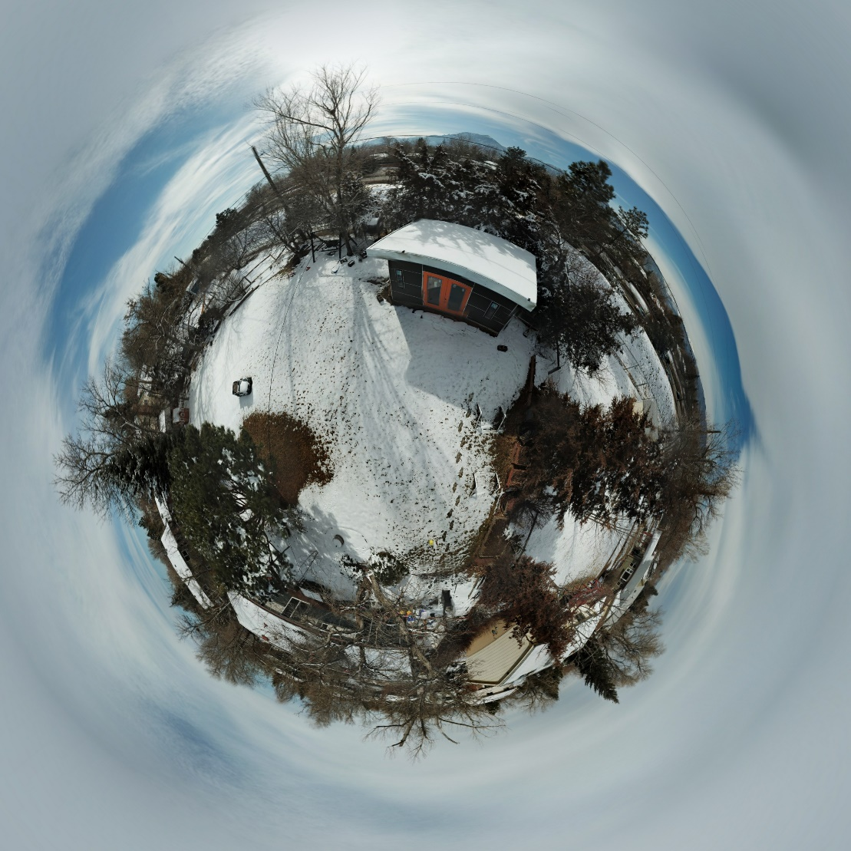
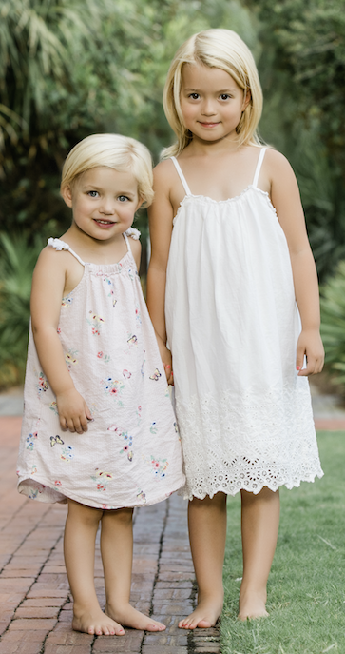
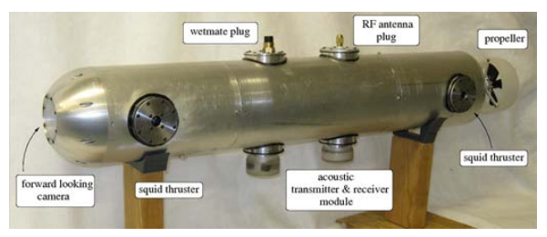
Bobby Hodgkinson
‘Boring’ video. ABET rqmt.
BS/MS CU Aerospace 2011
Sko Buffs
UF robotics 2011-2013
CU 2013+
Sku Buffs (again)
Drone
Family
DIY

Slide 3
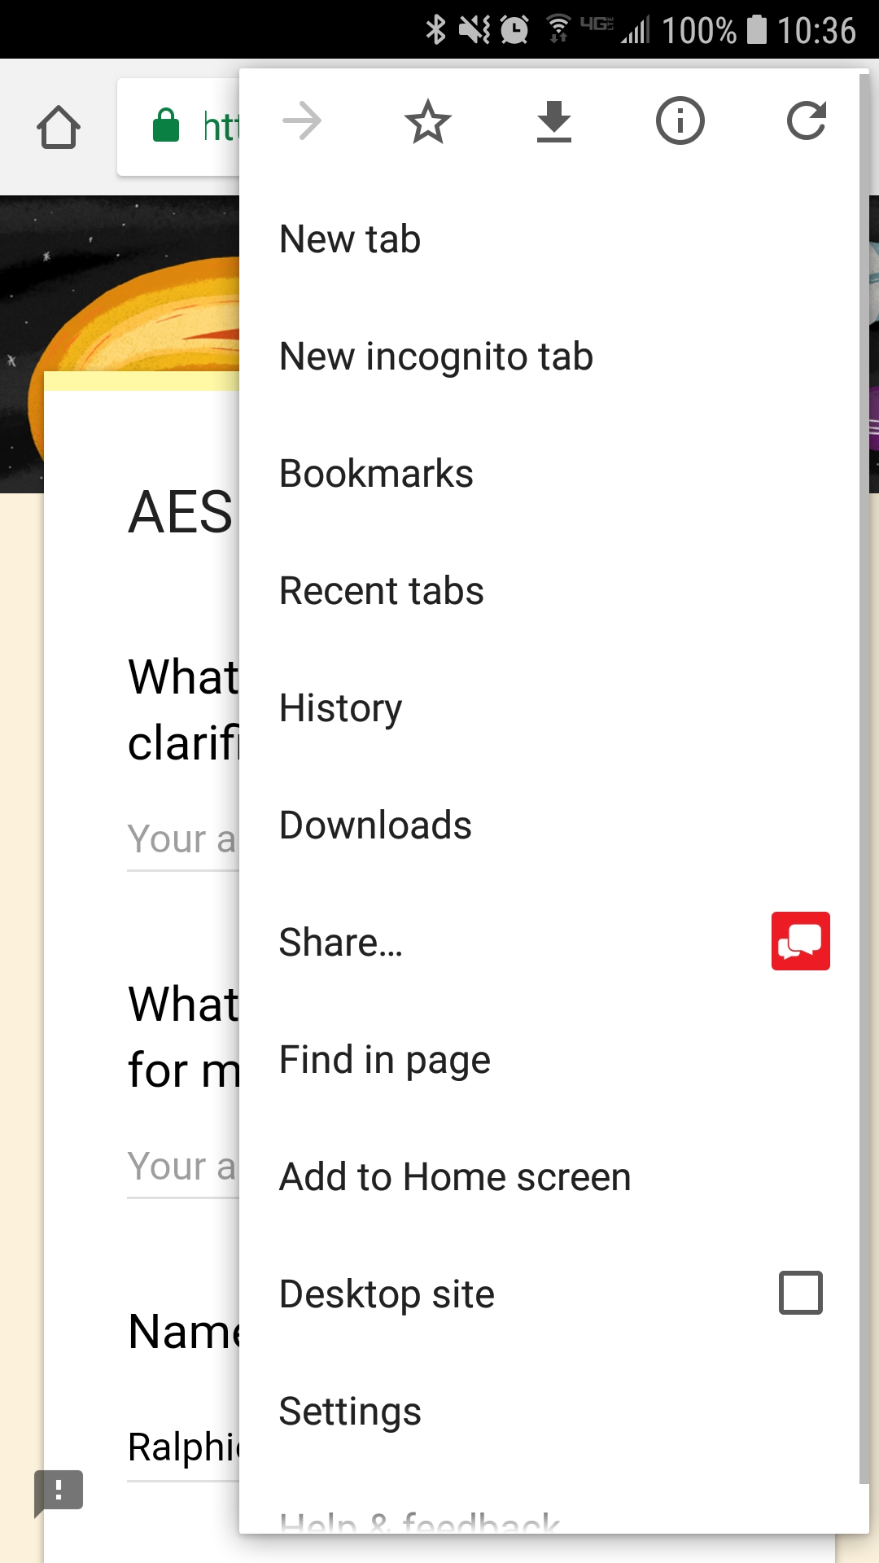
Bobby Hodgkinson
In your shoes in 2006.
I struggled with sophomore classes.
I wasn’t ready.
But I learned a lot.
Mainly to ask for help.
My Job: Help you learn, understand
Vs. ‘Teach’
Help me help you.
Teach me
“App” Go to: https://goo.gl/Xu2Wmh

Slide 4
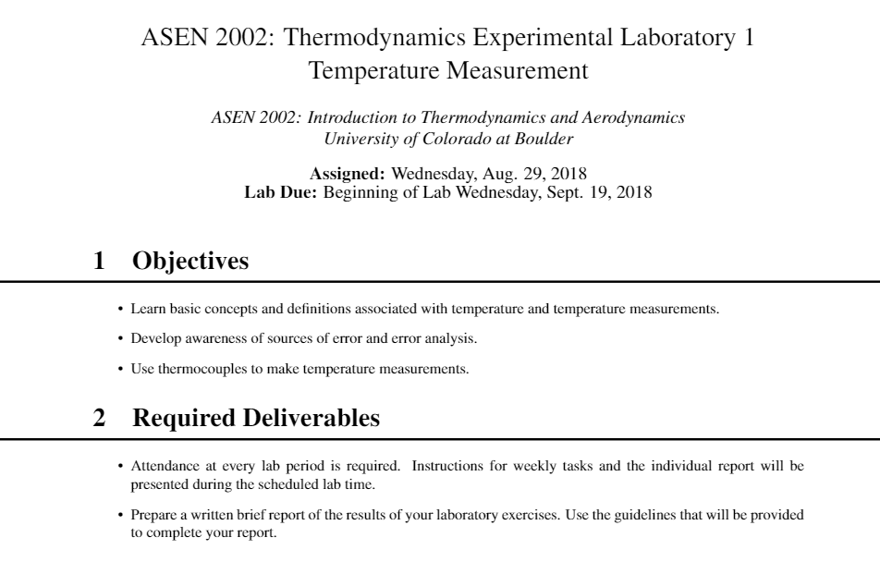

Slide 5
Schedule:
Assigned: 8/29. Due 9/19
8/29:
Introduction to lab.
Seeback Effect
How to record data
Build Thermocouple pair.
Record Data using thermocouple pair
9/05:
Multimeter Accuracy
Error analysis
Finish recording data from 8/29 using thermocouple pair
CJC IF ready
9/12:
Finish recoding data from 9/05
Pair of pairs for CJC

Slide 6
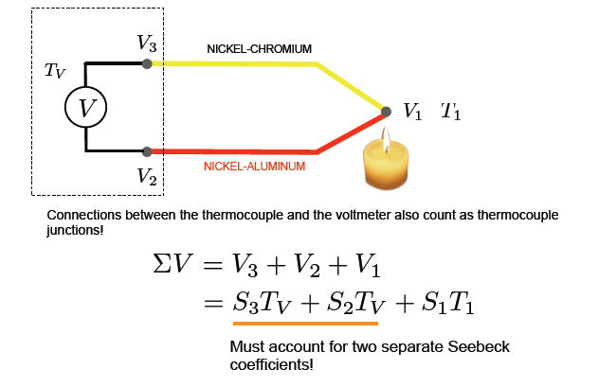
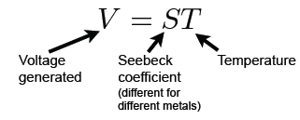
Seebeck Effect for Dissimilar Metals:
K-Type Thermocouple
+
-

Slide 7
Apply Kirchhoff’s Law for Circuits
Equivalent circuit for the case with J1 at a
higher temperature
Loop Rule – the sum of the voltage changes around a closed path, or loop, in the circuit must add to zero
For the chosen direction (let’s pick counter clockwise starting from the lower terminal)
V=-ε, if direction of the loop crosses a battery from + to – (high to low potential)
V=+ε, if direction of the loop crosses a battery, from – to + (low to high potential)
V₄ represents the multimeter measured voltage
V_{1,2,3} represents emf’s for each junction of dissimilar metals. Must know the types of metals, their Seebeck coefficients, and the temperature at each junction to determine the total emf. If same dissimilar metals and same temperature at junction 2 and 3 then their voltages cancel out and the desired result is found

Slide 8
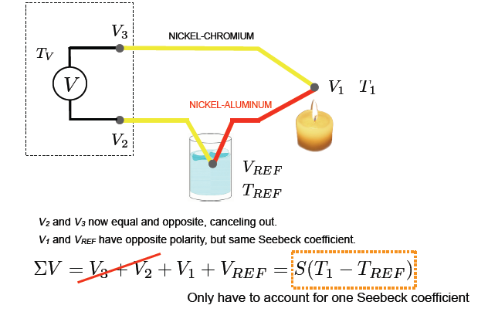
Thermocouple Pair
Using banana plugs, the thermocouple
is plugged into the multimeter.
The two materials are welded.
+
-
Using the wire nuts,
the two thermocouples
are connected at the red ends.

Slide 9
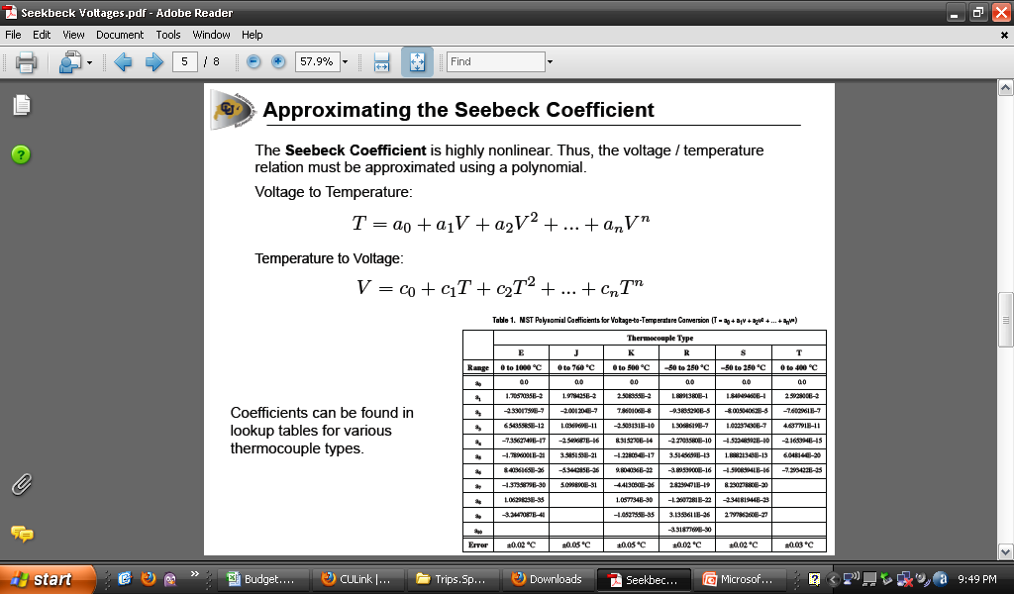
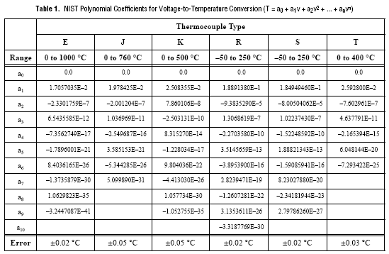
Make sure to use MICROVOLTS

Slide 10
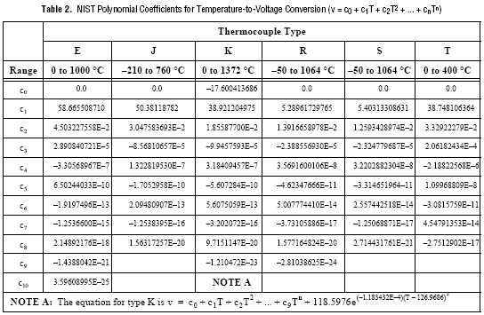

Slide 11
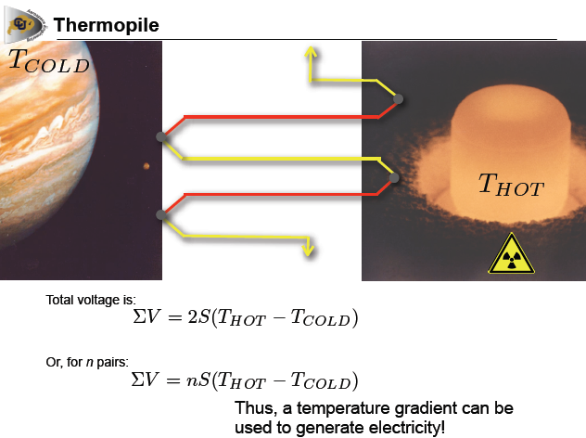

Slide 12
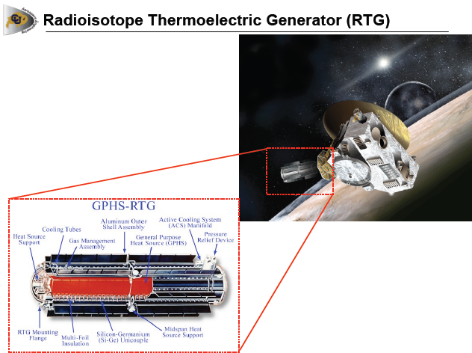
Notes:
RTG is from Cassinni and the Probe is New Horizons

Slide 13
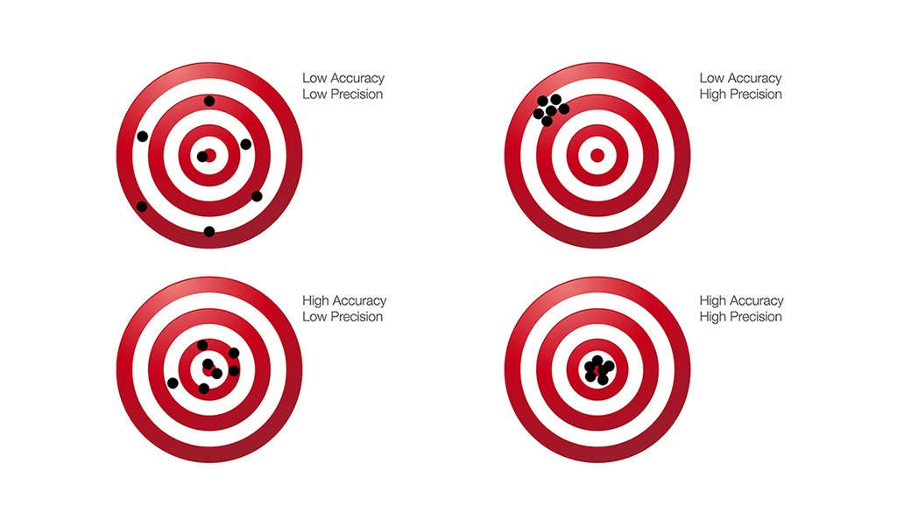
How to record multimeter readings
Significant figures and uncertainty
0.123 +/- 0.002
0.1234 +/- 0.0005
1.20 +/- 0.05
Real readings
Place finger over highest order ‘jumping digit’
How ‘confident’ are you in the result? Uncertainty.
Don’t overexagerate the quality
Video - https://youtu.be/19ZnRRCGBgM
Accuracy vs. precision
More on this next lab

Slide 14
Voltage Measurements and Errors
Complete Test Matrix Spreadsheet
Measured Voltage (Third Column): Record multimeter values
Observed voltage error (Fourth Column):
Estimate uncertainty in measured voltage by observing the digital display and assigning the object’s voltage uncertainty to the least significant digit on the display (a range value for the first right-most digit value that is flipping, for example maybe you observe a +- 10 mV flipping).
Compute Multimeter error (Fifth Column):
Calculate the expected voltmeter error using the formula provided in the 34461A multimeter handout and relate that to the error observed in reading the voltage from the display.
Reference Voltages (Sixth Column) and error:
Ice bath Vref computed from ice bath Tref using NI Table 2
Ice bath Vref uncertainty assumed negligible
Boiling water Vref from boiling water Tref using NI Table 2
Boiling water Vref uncertainty determined by adding and subtracting an uncertainty to the Tref value and compute the higher and lower voltage values using the NI Table 2
Ice bath – Ice bath measurement (Seventh Column): Record observed voltage reading from multimeter when both thermocouples are in the ice bath
Object’s voltage (Eighth Column): See next slide
Object’s voltage uncertainty (Ninth Column): See next slide

Slide 15
Build a thermocouple pair
Youtube:
‘Ann and H.J. Smead AES Laboratory and Shops Videos’
https://youtu.be/_r0VY9ulaAw

Slide 16
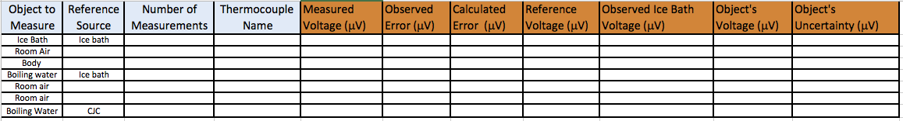
Excel Sheet
Complete Test Matrix Spreadsheet
Measured Voltage (Third Column): Record multimeter values
Observed voltage error (Fourth Column):
Estimate uncertainty in measured voltage by observing the digital display and assigning the object’s voltage uncertainty to the least significant digit on the display (a range value for the first right-most digit value that is flipping, for example maybe you observe a +- 10 mV flipping).
Compute Multimeter error (Fifth Column):
Calculate the expected voltmeter error using the formula provided in the 34461A multimeter handout and relate that to the error observed in reading the voltage from the display.
Reference Voltages (Sixth Column) and error:
Ice bath Vref computed from ice bath Tref using NI Table 2
Ice bath Vref uncertainty assumed negligible
Boiling water Vref from boiling water Tref using NI Table 2
Boiling water Vref uncertainty determined by adding and subtracting an uncertainty to the Tref value and compute the higher and lower voltage values using the NI Table 2
Ice bath – Ice bath measurement (Seventh Column): Record observed voltage reading from multimeter when both thermocouples are in the ice bath
Object’s voltage (Eighth Column): See next slide
Object’s voltage uncertainty (Ninth Column): See next slide

Slide 17
Object Voltage and Error Analysis
Consider systematic biases and statistical uncertainties in voltages –> ASEN2012
Object Voltage Estimate (Eighth Column)
Account for reference voltage and be careful of the polarity:
Use the measurement with both thermocouples in the ice bath to estimate a systematic uncertainty present in the experiment (ideally this result should approach the uncertainty of the multimeter). If this value exceeds the multimeter uncertainty, it will represent a voltage bias introduced by the experiment and may need to be removed for a more accurate result
Object Voltage Error (Ninth Column)
Assuming each voltage estimate (measured, reference, and systematic bias) has an error and, assuming they are all independent random errors, then the total error for the object voltage is a combination of errors from each voltage value, “summed in quadrature”
Decide on what errors to include in your assessment (may need to revisit as you may not recognize errors until evaluating your final temperature results).

Slide 18
Error Analysis
Body Voltage Estimates
Mean Voltage
When computing body temperature from 10 measurements, compute the mean value assuming the errors from the “n” measurements are all similar
Error of the Mean
Compute the error of the mean by computing the sample Standard Deviation and divide by square root of n

Slide 19
Temperature Estimates
Temperature Retrieval
Temperatures and Errors
Determine temperature from voltage estimate using NI Table 1
Determine error in temperature by adding and subtracting the object’s voltage error to the value of the object’s voltage, and plug these values into the voltage-to-temperature relationship to get your temperature range
Reference Temperatures
For ice bath, T_{ref} = 0.0ºC and assume error in T_{ref} is negligible. Compute the voltage contribution for this temperature using the temperature-to-voltage relationship for K-type thermocouple
Tref for boiling water – how should we calculate it? (you decide and document in report)
Calculate based on atmospheric pressure (XX.X kPa)
Get temperature from earlier measurement using ice bath
Calculate error in temperature estimate of reference bath – either by uncertainty in pressure or uncertainty in measurement
Repeat for all Required Measurements
How precise is your thermocouple and methods used in determining temperature of an object?

Slide 20
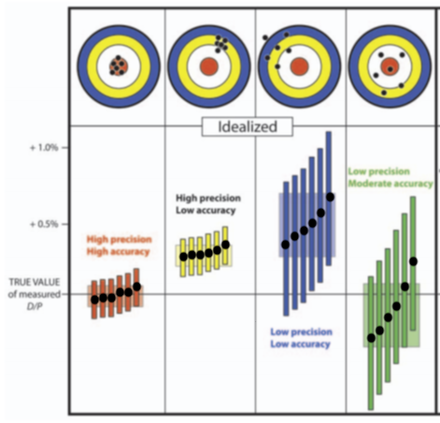
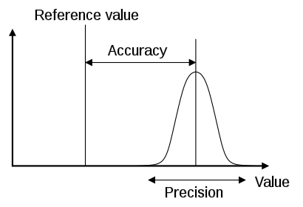
Clarification
Notes:
Image from: https://www.princeton.edu/geosciences/people/schoene/pdf/Schoene_precision-accuracy_Elements13.pdf

Slide 21
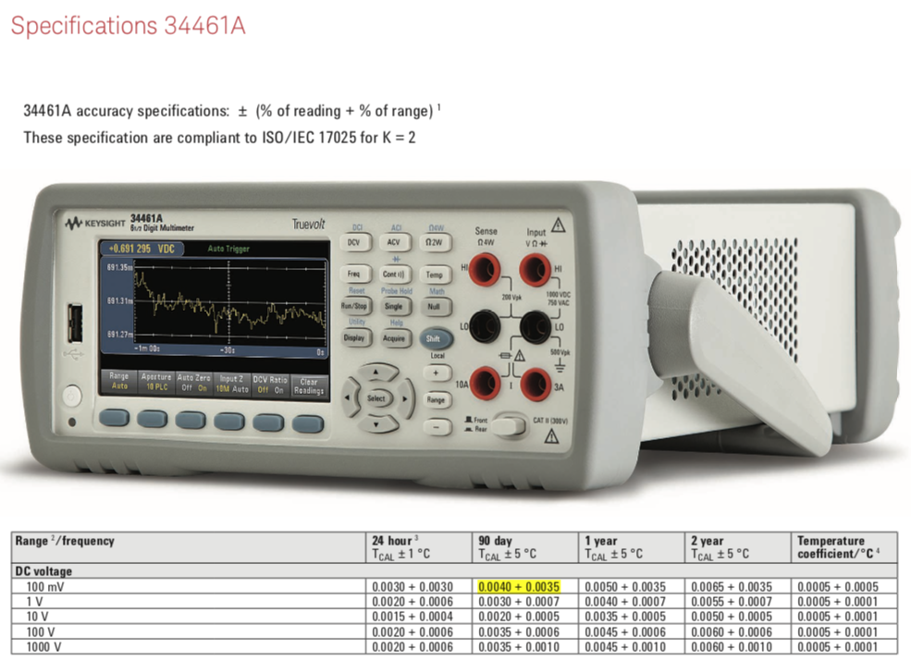

Slide 22
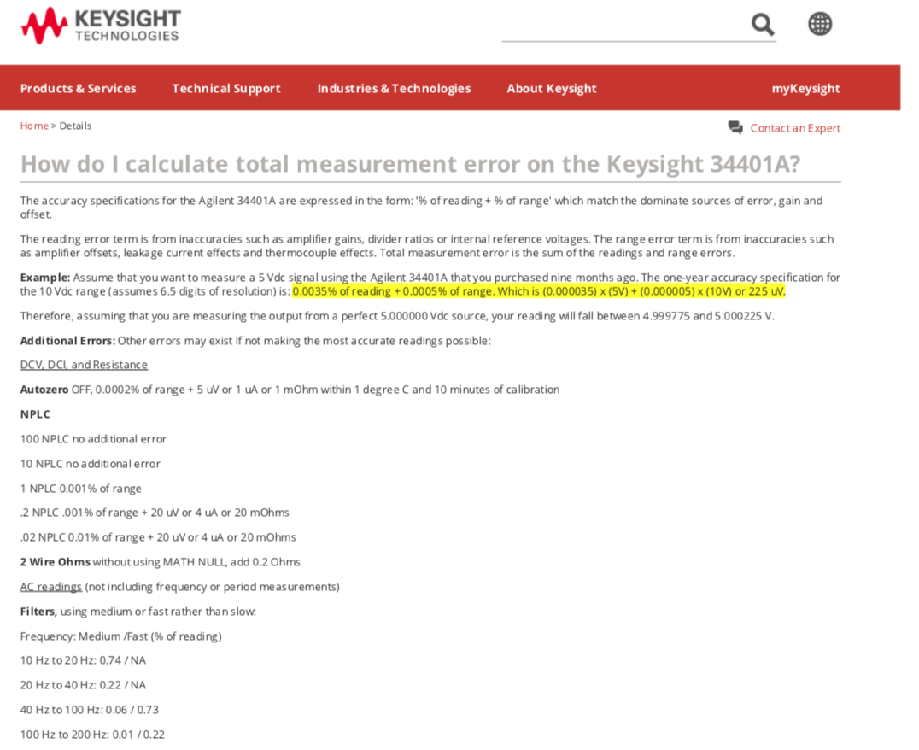
Multimeter Accuracy

